Slide 1
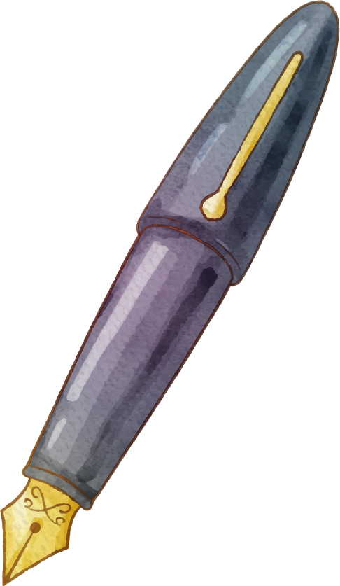











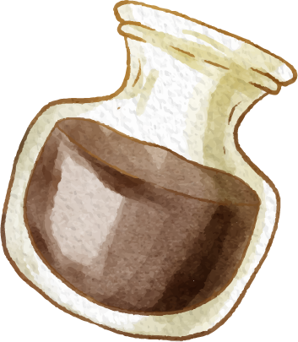





Present and Past Tenses (Simple and Continuous)

Slide 2






How many tenses are there in English language?

Slide 3
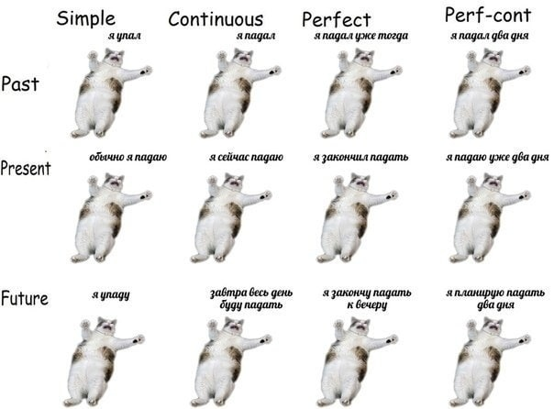

Slide 4

01
Present Simple and Present Continuous

Slide 5
Find sentences in Present Simple and Present Continuous
She is eating dinner now.
Earth rotates around the Sun.
She never comes home early.
She plays Tennis every day.
Today I’m cleaning the house.
Jack is going to Greece today in the evening.
She’s learning how to drive.
36,6 is a normal temperature for humans.

Slide 6
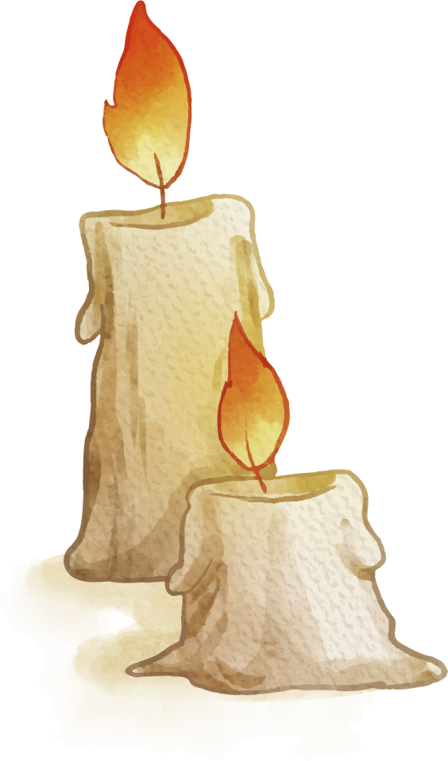
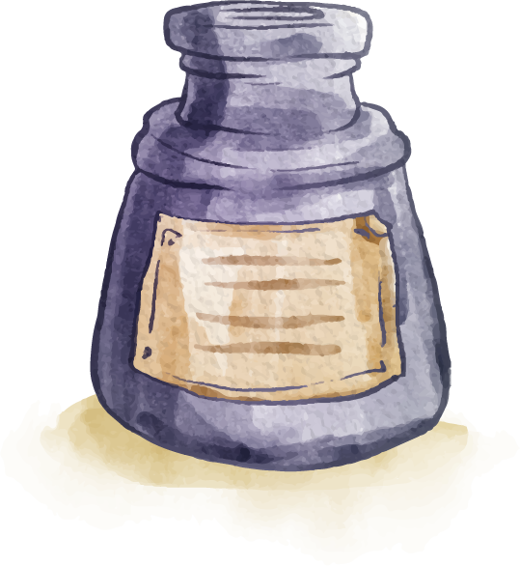
Structure
Present
Simple
Present
Continuous
DO / DOES in negative sentences and questions
TO BE + Ving

Slide 7
Make two groups
Present Simple
Present Continuous
With stative verbs
Facts
Regular actions
Actions at the moment of speaking
Actions around this time
For future arrangements

Slide 8
Make two groups
Present Simple
Present Continuous
Facts;
Actions that happen regular, always or never;
With stative verbs;
Actions at the moment of speaking;
Actions around this time:
For future arrangements

Slide 9
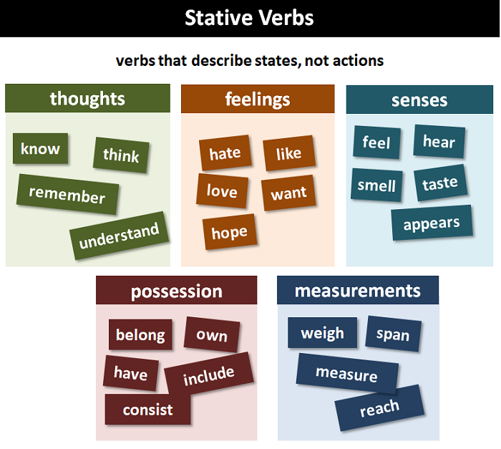
Stative Verbs

Slide 10
02
Past Simple and Past Continuous

Slide 11
Structure
Past
Simple
Past
Continuous
DID in negative sentences or questions
WAS / WERE + Ving

Slide 12
Make two groups
Past Simple
Past Continuous
With stative verbs
Facts in the past
Action in the past with a date
Continuous action in the past

Slide 13
Make two groups
Past Simple
Past Continuous
Facts in the past
With stative verbs
Continuous action in the past
Action in the past with a date

Slide 14
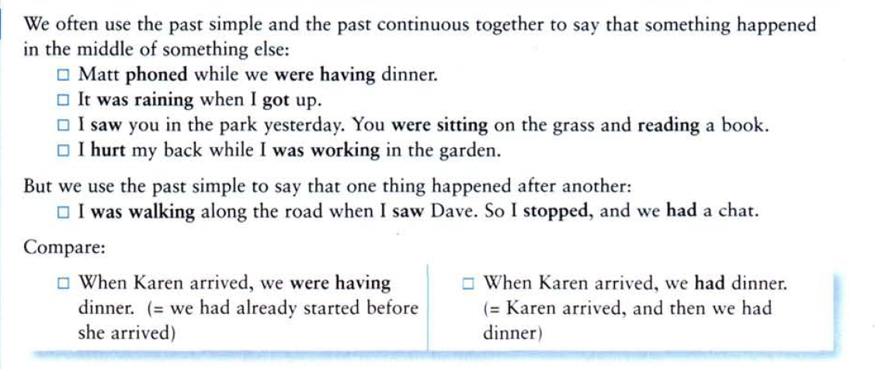
Past Simple and Past Continuous

